Slide 1

Operating systems
I/O Management, System Protection and Security
Venkatesh Prasad
Department of Computer Science

Slide 2
Operating systems
I/O Systems - DMA
Venkatesh Prasad
Department of Computer Science

Slide 3
OPERATING SYSTEMS
Slides Credits for all PPTs of this course
The slides/diagrams in this course are an adaptation, combination, and enhancement of material from the following resources and persons:
Slides of Operating System Concepts, Abraham Silberschatz, Peter Baer Galvin, Greg Gagne - 9th edition 2013 and some slides from 10th edition 2018
Some conceptual text and diagram from Operating Systems - Internals and Design Principles, William Stallings, 9th edition 2018
Some presentation transcripts from A. Frank – P. Weisberg
Some conceptual text from Operating Systems: Three Easy Pieces, Remzi Arpaci-Dusseau, Andrea Arpaci Dusseau

Slide 4
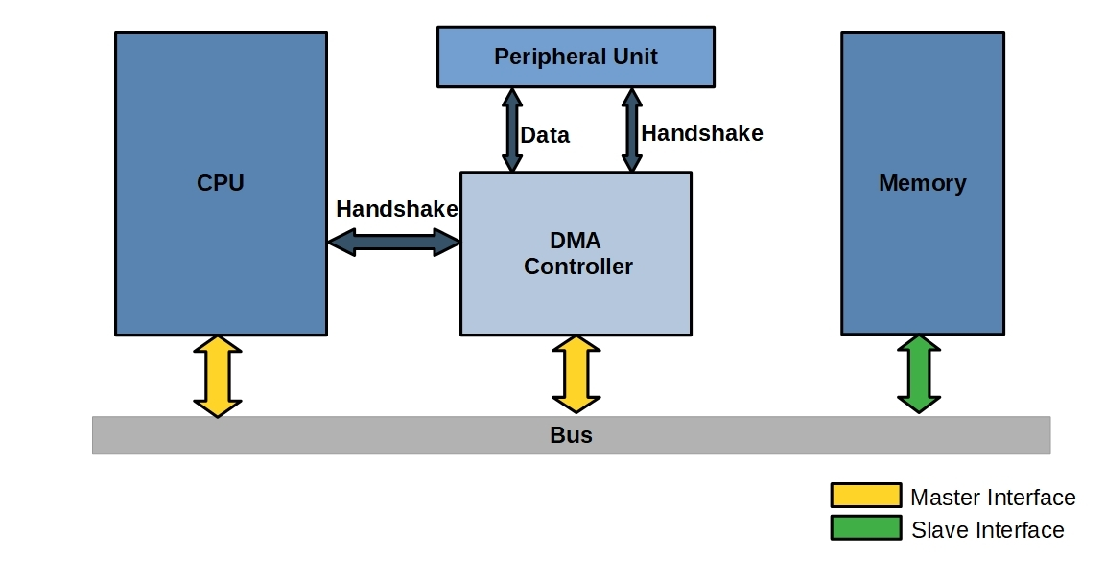
OPERATING SYSTEMS
Direct Memory Access
Direct Memory Access (DMA) transfers the block of data between the memory and peripheral devices of the system, without the participation of the processor.
The unit that controls the activity of accessing memory directly is called a DMA controller.
Used to avoid programmed I/O (one byte at a time) for large data movement
Bypasses CPU to transfer data directly between I/O device and memory
A simple DMA controller is a standard component in all modern computers, from smartphones to mainframes.
Handshaking between DMA controller and device controller is performed via a pair of wires called DMA-request and DMA-acknowledge
CPU and DMA controller have master interfaces to initiate transfers

Slide 5
OPERATING SYSTEMS
Direct Memory Access (Cont.)
OS writes DMA command block into memory
Source and destination addresses
Read or write mode
Count of bytes
Writes location of command block to DMA controller
Bus mastering of DMA controller – seizes the memory bus from CPU
Cycle stealing from CPU (i.e CPU is momentarily prevented from accessing main memory but it can still access data items in its primary and secondary caches) but still much more efficient
When done, interrupts to signal completion
Version that is aware of virtual addresses can be even more efficient – DVMA (Direct Virtual Memory Access)
Notes:
Some computer architectures use physical memory addresses for DMA, but others perform
direct virtual memory access (DVMA), using virtual addresses that undergo translation to physical addresses.
DVMA can perform a transfer between two memory-mapped devices without the intervention of
the CPU or the use of main memory.

Slide 6
OPERATING SYSTEMS
Six Step Process to Perform DMA Transfer

Slide 7




OPERATING SYSTEMS
CPU utilization
CPU wastes a lot of time to copy the a large chunk of data from memory to the device.
“over-burdened”
: task 1
: task 2
: copy data from memory
CPU
Disk

Slide 8





OPERATING SYSTEMS
CPU utilization by DMA
Copy data in memory by knowing “where the data lives in memory, how much data to copy”
When completed, DMA raises an interrupt, I/O begins on Disk.
: task 1
: task 2
: copy data from memory
CPU
DMA
Disk

Slide 9
OPERATING SYSTEMS
DMA Transfer Modes
The DMA controller transfers the data in three modes:
Burst Mode: Here, once the DMA controller gains the charge of the system bus, then it releases the system bus only after completion of data transfer. Till then the CPU has to wait for the system buses.
Cycle Stealing Mode: In this mode, the DMA controller forces the CPU to stop its operation and relinquish the control over the bus for a short term to DMA controller. After the transfer of every byte, the DMA controller releases the bus and then again requests for the system bus. In this way, the DMA controller steals the clock cycle for transferring every byte.
Transparent Mode: Here, the DMA controller takes the charge of system bus only if the processor does not require the system bus.

Slide 10
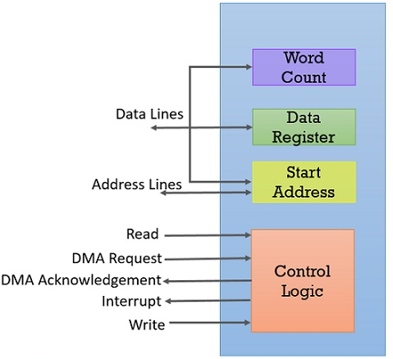
OPERATING SYSTEMS
DMA Block Diagram

Slide 11
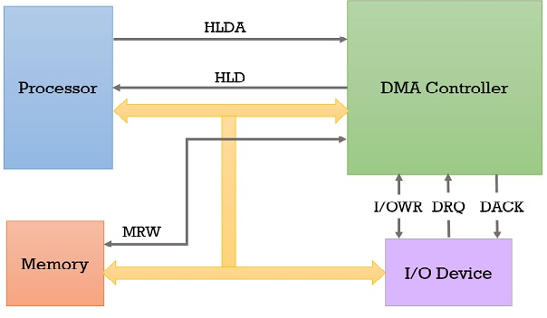
OPERATING SYSTEMS
DMA Controller Data Transfer
I/O device sends the DMA request (DRQ) to the DMA controller.
DMA controller accepts this DRQ and asks the CPU to hold for a few clock cycles by sending it the Hold request (HLD).
CPU receives the Hold request (HLD) from DMA controller and relinquishes the bus and sends the Hold acknowledgement (HLDA) to DMA controller.
DMA controller acknowledges I/O device (DACK) that the data transfer can be performed and DMA controller takes charge of the system bus and transfers the data to or from memory.
When the data transfer is accomplished, the DMA sends an interrupt to the processor

Slide 12

THANK YOU
Venkatesh Prasad
Department of Computer Science Engineering
venkateshprasad@pes.edu

